Slide 1
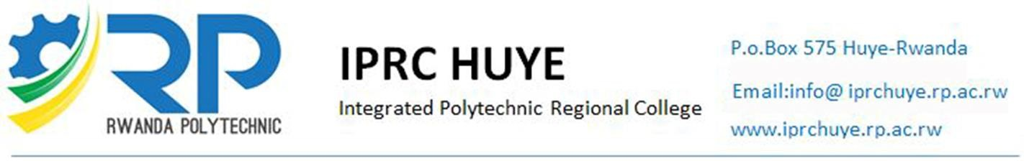
DEPARTMENT OF INFORMATION COMMUNICATION TECHNOLOGY
PROJECT
DESIGN AND IMPLEMENTATION OF A SMART CROP DRYING SYSTEM
(Case study ABAJYANA NIGIHE COOPERATIVE).
Prepared by:
IDUFASHE Christian 19RP03025
IRADUKUNDA Honorine 19RP09304

Slide 2
ABSTRACT
Agriculture has been and will always be one of the most important sectors in the world.
Though this sector is so important it still faces some challenges, as the world population increases, we must produce as much food as possible, one of the many ways to increase our products is to take good care of the harvest so that we can minimize the products lost during the time of harvest while also making sure that our products meet the standard industrial quality of our area.
That’s why we directed our research project into developing an IoT automated system that will help farmers during the harvest time to automate the process of sun drying.
Our system is embedded with Smart electronic devices and sensors or actuators, web part. So those electronic devices it contains with sensors to measure the surrounding atmospheric conditions like the temperature, humidity, sun intensity, and detect rain drops depending on the values read the device will automatically close or open the store for sun drying, this device will also continuously send data to the server for storage and further analysis. The next part is web application that where the farmers will be able to remotely see the atmospheric status of the area in their farm, monitor, provide a visual statistical data and control the open and close of the roof through the web application. This project report illustrates the steps, materials and components needed to design and implement this project.

Slide 3
BACKGROUND OF THE STUDY
Research of information was done For ABANJYANA NIGIHE KABERE COOPERATIVE That Located in Northern province, MUSANZE District, MUKO sector, where we found that the information of their crops (Maize and Beans) are Drying manually and sometimes they needs some space for the crops to dry which most of the farmers don’t have it and it take loads of time to dry up.. This system is to be used by the farmers of ABANJYANANIGIHE COOPERATIVE as it is our case study in order to solve some problems found there.

Slide 4
PROBLEM STATEMENTS
When unseasonal rain falls on the harvested crops, which are kept to dried up, they rot up and get destroyed due to which farmers have to face enigma. Some crops must be dried before it is sold to the agriculture market yard.
The farmer needs some space for the crops to dry which most of the farmers don’t have it and it take loads of time to dry up.
When the temperature changed down directly, farmers needs to move their products from out, here they can late so the product can meet with the rain drops that can let damaging of their products. That can cause also the loss of many products.
This manual system it requires large number of unskilled Labour and it takes the long time.
High cost of drying, Requires skilled personnel and regular monitoring, Risk of breakdown or fuel shortage at critical times.

Slide 5
OBJECTIVES OF STUDY
General objectives:
The main objective is to design and implement a “Smart Crop Drying System " that will detect raindrops depending on the values read the device will automatically close or open the store for sun drying, this device will also continuously send data to the server for storage and further analysis.
Specific objectives:
The specific objectives of this research are as follow:
This device is used in agriculture purpose in a way when the rain drops falls on the rain sensor, the roof automatically gets over the crops kept for drying
Used for prevent the harvested crops from the heavy rain and save the rain water.
Drying is needed for the future storage of crops
Drying saves crops from different types of insects or pests that cause crops damage.
Drying is essential to improve seed quality.
To improve nutritive value, drying is needed.
Small amount of labour is required and It takes very short time.

Slide 6
SCOPE OF STUDY
This project is able for measure the surrounding atmospheric conditions like the temperature, humidity, sun intensity, and detect rain drops depending on the values read the device will automatically close or open the store for sun drying, this device will also continuously send data to the server for storage and further analysis and It have the web application that will be able to remotely see the atmospheric status of the area in their farm, monitor , provide a visual statistical data and control the open and close of the roof through the web application

Slide 7
LITERATURE REVIEW
INTRODUCTION
Smart Crop Drying System is system that will help farmers during the harvest time to automate the process of sun drying depending on the values read the device will automatically close or open the store for sun drying and user can open or close the roof when their happen something which is emergency, this device will also continuously send data to the server for storage and further analysis.
The main electronic devices used in this system are:
Microcontroller
Arduino-Uno
DC Motor
ESP32
DHT11 Sensor
Rain Sensor
Wires and Resistors

Slide 8
STUDY AREA
ABANJYANA NIGIHE KABERE COOPERATIVE is located in Northern Province, MUSANZE District, MUKO Sector, CYOGO Cell and KABERE Village near KABERE Health Center.
In 2011, twenty eight (28) people joined together as cooperative members with the name of “ABANJYANA NIGIHE COOPERATIVE KABERE” in order to support one to each other for improving their standard of living through cultivation of vegetables and fruits where they took their harvest and they sold together to get more profit, After five year in 2016 they changed cultivation into maize and beans and then after they joined by other members that comes from Regional Sector, now the cooperative members are equal to 118 peoples as Their President (WIBABARA Fidel) They Told us .
This cultivation take place on four(4)Hectares, in the harvest time they gain 80 up to 100 Tones and their cultivation moved in the distance from the field to the housekeeping is equal to 2km as maximum distance.

Slide 9
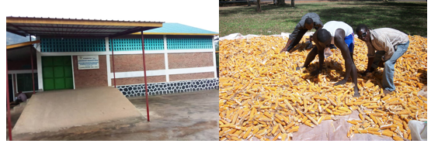
STUDY DESIGN
ABANJYANA NIGIHE KABERE COOPERATIVE Is cooperative that located in MUSANZE District as we said above, they make cultivation of beans and maize.
They use manual drying on by using Solar to eliminate the moisture content from their crops.
The solar dryer consists of cheap material like cement so on the top surface of the dryer is covered by transparent single and double-layered sheets on distance 80m.
When unseasonal rain falls on the harvested crops, the farmer try to pick up quickly their crops to avoid rain drops on their crops, they moved from the sheets on the ground to housekeeping to keep them. That why we conclude to design this system that called Smart Crop Drying System that help them in rain period.
HOUSE KEEPING OF ABANJYANA NIGIHE COOPERATIVE

Slide 10
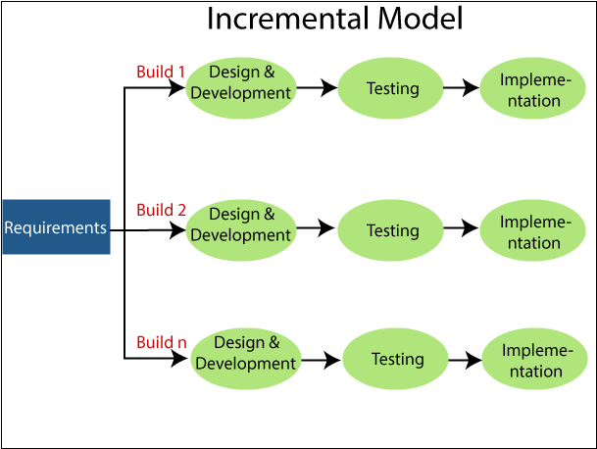
Software Development Process Models
What is Prototype Model?
The Prototype model is one of the software development life cycle models in which a prototype is built with minimal requirements. This prototype is then tested and modified based on the feedback received from the client until a final prototype with desired functionalities gets created.
Prototype model has different types which are: Rapid Throwaway Prototyping, Evolutionary Prototyping, Incremental Prototyping and Extreme Prototyping in our system we are choose incremental prototyping.

Slide 11
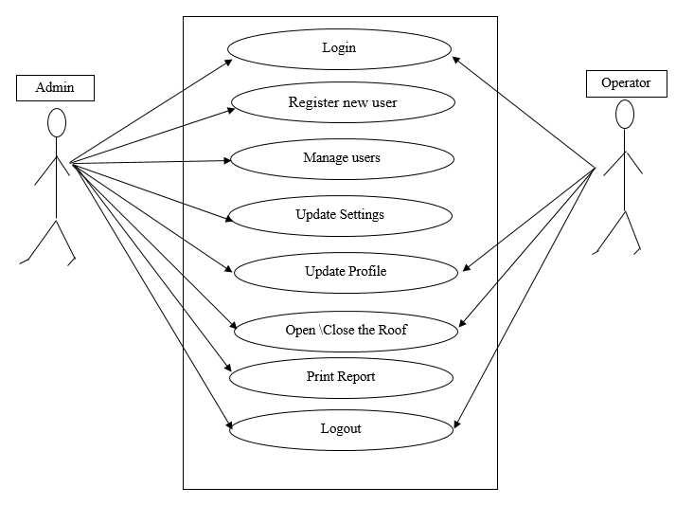
SYSTEM DESIGN AND MODELING
UML
UML stands for Unified Modeling Language. It's a rich language to model software solutions, application structures, system behavior and business processes, there are two main categories; structure diagrams and behavioral diagrams.
USE CASE DIAGRAM OF THE SYSTEM

Slide 12
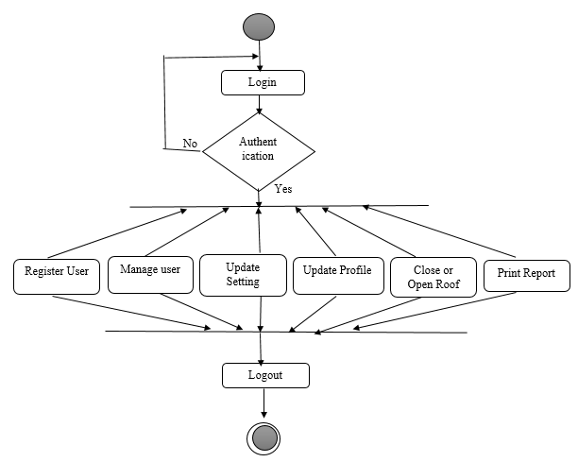
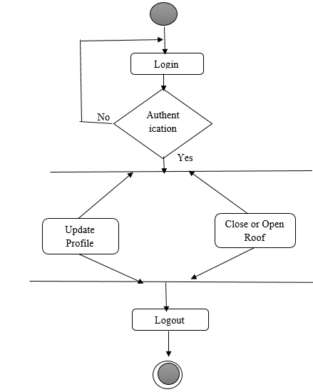
ACTIVITY DIAGRAMS
Activity diagram is another important diagram in UML to describe the dynamic aspects of the system. Activity diagram is basically a flowchart to represent the flow from one activity to another activity.
Activity diagram of Admin
Activity diagram of Operator

Slide 13
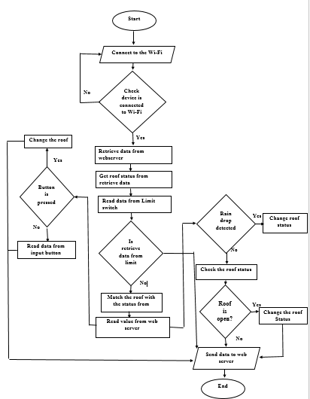
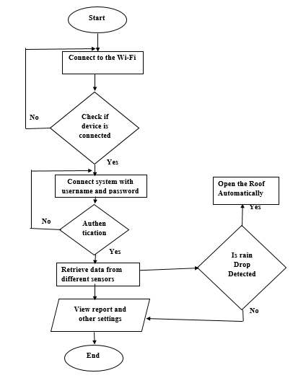
SYSTEM ANALYSIS
Flowchart that shows how the System Circuit Board it work Flowchart that show how Web application it works

Slide 14
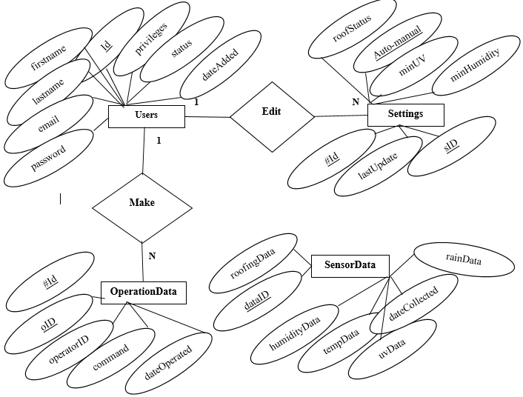
Entity Relationship Diagram (ERD).
ERD is a diagram which shows entities (tables) and relationships among those entities Smart Crop Dry System

Slide 15
Conclusion
The Smart Crop Drying System has been achieved successfully using microcontroller unit. The circuit has been tested and verified. We Developed Automatic roof for crop protection shed programmed by using the microcontroller. The program has been successfully tested and verified for several specified conditions. The switching mechanism can be done automatically with the help of microcontroller using DC motor.
By using this project we can protect Our Products in the period of unseasonal rain. We can also increase the rate of production of crops by which we can improve the economical standards of farmers and as production increases the cost of the crop decreases for the users So Using this system eliminates human power and requirement to provide automatic roof mechanism.
Recommendation
We recommend RAB to enable the best use of the system, we recommend training of the farmers and equipping them with the IoT skills required to run the system.
We recommend government to use this system in Different Cooperatives.
We recommend IPRC HUYE to link us with sector related to the Crop Drying System.
We recommend anyone who can be having any improvement to add to this system in order to achieve goal at higher level that they are allowed to modify it Such as system used for Crop Drying by using Solar energy or electrical energy that help the farmer to Dry up their products in the Rain Season.

Slide 16
End Of Presentation
Thank you!

